Slide 1
When Function Inlining Meets WebAssembly: Counterintuitive Impacts on Runtime Performance
Alan Romano Weihang Wang

Slide 2
What is WebAssembly (Wasm)?
Enables high-performance computations at near-native speeds
Compiled binary format for efficient network transmission
Compilation target for C, C++, Rust, Go, Kotlin, Swift, etc …

Slide 3
WebAssembly Compilation and Execution Pipeline
Output
Chromium
Emscripten Compiler Pipeline
.wasm
.wasm
Liftoff
Input
IR
wasm-opt
.wasm
O2-O3
O2-O3
TurboFan
IR
IR
Module
</>
Frontend
IR
Middle-end
CodeGen
Firefox
Source Code
(.c/.cpp)
.wasm
Wasm-Baseline
Clang
IR
O0-O1
JS Support Code
Wasm-Ion
LLVM Tool
Binaryen Tool

Slide 4
Chromium Tier-Up Process
Execution Pipeline
Liftoff
TurboFan
$main (
call $f1
…
call $f1
)
Main Thread
JavaScript
$main Call
$f1 Call
$f1 Call
$main Compilation Thread
$main
$main
$f1 Compilation Thread
$f1
$f1
$f1
1
JavaScript starts Wasm module
2
3
4
JavaScript
calls $main
$main
calls $f1
$main calls $f1 again

Slide 5
Incorrect Compilation Assumption
Assumption: WebAssembly compilation pipeline is same as native compilation
Unlike native binaries, WebAssembly modules usually undergo two compilation stages
One stage during source code compilation to WebAssembly
Second stage during browser execution to native code
These compilation stages can interfere with each other

Slide 6
Function Inlining in WebAssembly
Moves the code of a called function into its call sites
Normally, saves execution time spent on context switching
However, increased code size can interfere with tiering-up process
Source code
Before function inlining
After function inlining
int x;
function a() {
x = 123;
}
function b()
{
a();
return x
}
(func $a
i32.const 123
i32.const 1024
i32.store)
(func $b
call $a
i32.const 1024
i32.load
return)
(func $b
i32.const 123
i32.const 1024
i32.store
i32.const 1024
i32.load
return)
Counterintuitive impact - Applying optimization leads to slower runtime performance

Slide 7
When Function Inlining Meets WebAssembly
Perform the first in-depth study of function inlining effects on WebAssembly modules
Investigate three research questions:
RQ1 - Significance: How often does function inlining counterintuitively impact WebAssembly modules, and are the effects unique to WebAssembly?
RQ2 - Function Characteristics: Which characteristics of the inlined functions cause the counterintuitive behavior?
RQ3 - Quantification: How does excluding certain functions from inlining impact the counterintuitive effects?

Slide 8
Selecting C/C++ Source Programs
Subdirectory | # of Samples | # of LOC
Adobe-C++ | 6 | 696
BenchmarkGame | 8 | 549
CoyoteBench | 4 | 1,294
Dhrystone | 2 | 767
Linpack | 1 | 552
McGill | 4 | 956
Misc | 27 | 3,487
Misc-C++ | 7 | 1,341
Misc-C++-EH | 1 | 16,846
Polybench | 32 | 5,188
Shootout | 14 | 663
Shootout-C++ | 25 | 972
SmallPT | 1 | 102
Stanford | 11 | 1,332
Total | 143 | 34,745
Evaluate function inlining passes on C/C++ files from LLVM Test Suite
Complex enough to trigger optimization passes
Of 143 total samples, 16 cannot compile with Emscripten
127 programs in total

Slide 9
Designing Experiments
Experiment | Platform | Optimization Levels | LLVM Inlining Pass Enabled | Binaryen Inlining Pass Enabled
Baseline | Wasm & x64 | O0 - O3 | ✅ | ✅
1 | Wasm | O0 - O3 | ❌ | ❌
2 | x64 | O0 - O3 | ❌ | N/a
3 | Wasm | O0 - O3 | ❌ | ✅
4 | Wasm | O2 - O3 | ✅ | ❌
5 | Wasm | O2 - O3 | ✅ | Patched

Slide 10
RQ1: Significance of Counterintuitive Effects
Experiment 1 (Both Inlining Passes Disabled) in Chromium
32/127 in Chromium experience 5% speedup
15/127 in Chromium experience > 20% speedup

Slide 11
RQ1: Significance of Counterintuitive Effects
Experiment 1 (Both Inlining Passes Disabled) in Firefox
51/127 in Firefox experience 5% speedup
10/127 in Firefox experience > 20% speedup

Slide 12
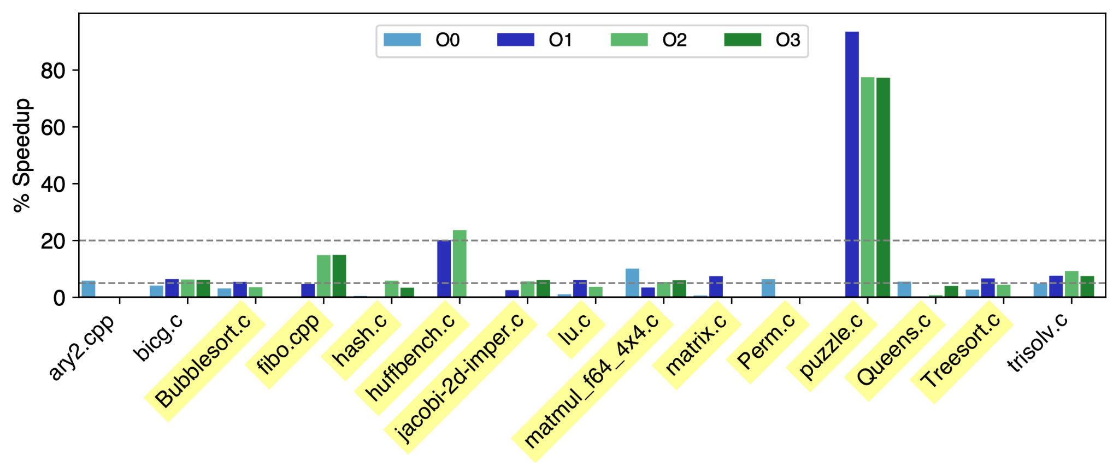
RQ1: Significance of Counterintuitive Effects (cont.)
Experiment 2 (Plain x64 vs x64 with no LLVM Inlining)
15/127 experience 5% speedup
12/15 experience speedup on both WebAssembly and x64
Exclude the 12 samples (highlighted in yellow) from later experiments

Slide 13
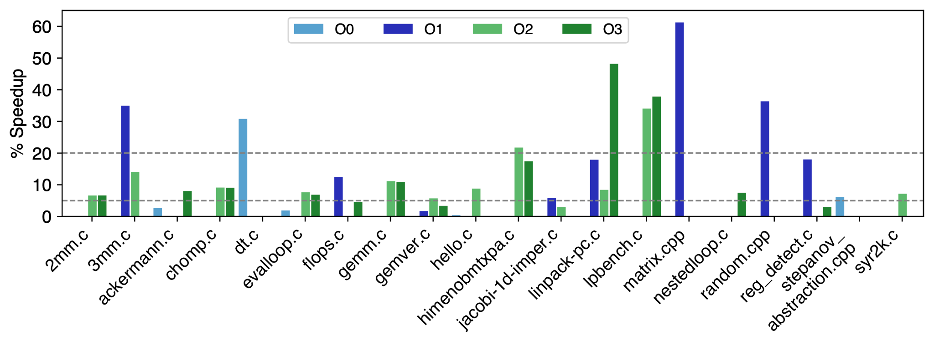
RQ2: Investigation of Function Characteristics Causing Counterintuitive Effects
Experiment 3 (LLVM Inlining Disabled / Binaryen Inlining Enabled)
20/127 in Chromium experience 5% speedup
7/127 in Chromium experience > 20% speedup

Slide 14
RQ2: Investigation of Function Characteristics Causing Counterintuitive Effects
Experiment 3 (LLVM Inlining Disabled / Binaryen Inlining Enabled)
32/127 in Firefox experience 5% speedup
7/127 in Firefox experience > 20% speedup

Slide 15
RQ2: Investigation of Function Characteristics Causing Counterintuitive Effects (cont.)
Experiment 4 (LLVM Inlining Enabled / Binaryen Inlining Disabled)
29/127 in Chromium experience 5% speedup
13/127 in Chromium experience > 20% speedup

Slide 16
RQ2: Investigation of Function Characteristics Causing Counterintuitive Effects (cont.)
Experiment 4 (LLVM Inlining Enabled / Binaryen Inlining Disabled)
40/127 in Firefox experience 5% speedup
13/127 in Firefox experience > 20% speedup

Slide 17
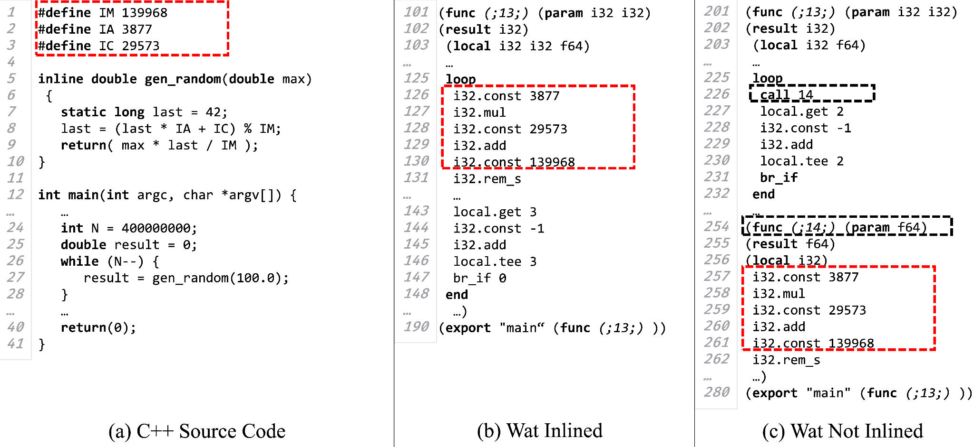
RQ2 Case Study: random.cpp

Slide 18
RQ2 Case Study: random.cpp (cont.)
Inspect Linux perf traces of Chromium when running this sample
LLVM Inlining Enabled
LLVM Inlining Disabled

Slide 19
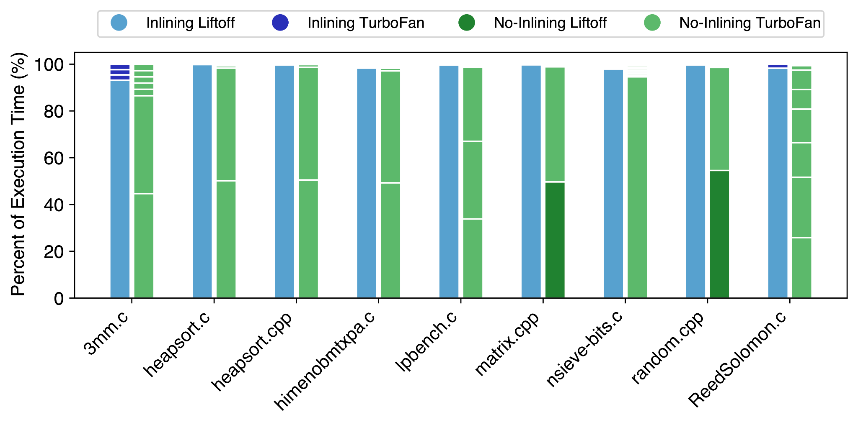
RQ2: Compiler Usage of Experiment 1 Samples (cont.)

Slide 20
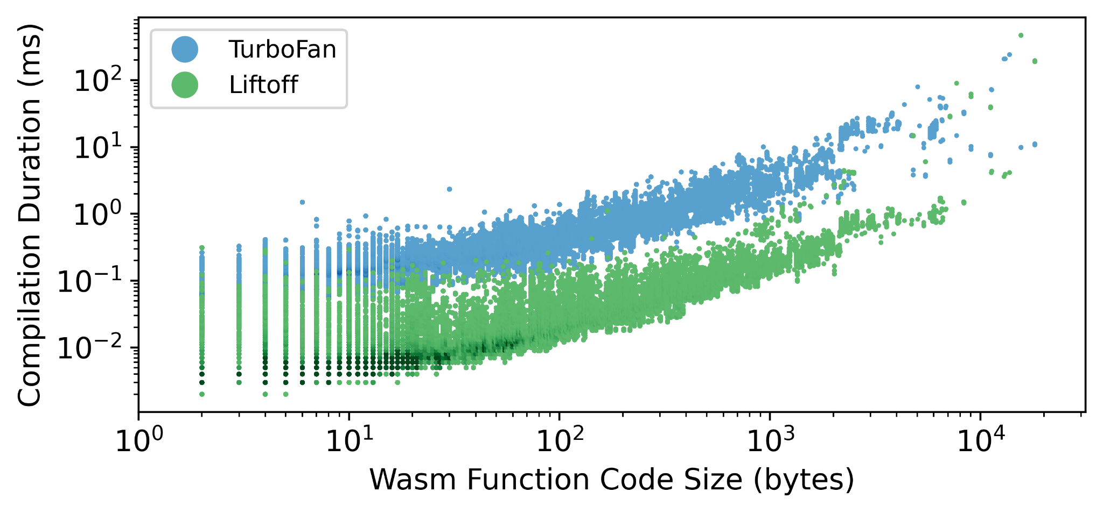
RQ2: Code Size Impact

Slide 21
RQ3: Impact of Hot Functions on Counterintuitive Effects
Experiment 5 (LLVM Inlining Enabled / Binaryen Inlining Patched)
Patch Binaryen to selectively disabled identified “hot” functions
24/29 in Chromium experience 5% speedup
14/29 in Chromium experience > 20% speedup

Slide 22
RQ3: Impact of Hot Functions on Counterintuitive Effects
Experiment 5 (LLVM Inlining Enabled / Binaryen Inlining Patched)
Patch Binaryen to selectively disabled identified “hot” functions
24/40 in Firefox experience 5% speedup
14/40 in Firefox experience > 20% speedup

Slide 23
Case Study on a Real-World Application: LibSodium.js
Cryptographic library ported to the web
Contains 75 example programs testing library APIs
Replicate Experiment 1 (Both Inlining Passes Disabled) on 75 programs
44/75 in Chromium experience 5% speedup

Slide 24
Case Study on a Real-World Application: LibSodium.js
Cryptographic library ported to the web
Contains 75 example programs testing library APIs
Replicate Experiment 1 (Both Inlining Passes Disabled) on 75 programs
58/75 in Firefox experience 5% speedup

Slide 25
Limitations
Precision of custom-built JavaScript timer is limited
Browsers limit to millisecond resolution
Too large to measure a typical WebAssembly call
Only inspect Chromium and Firefox
Each browser adds manual effort
Together, these browsers account for 74% of market share [1]

Slide 26
Threats to Validity
Internal Validity
Manually inspect each compiled sample to ensure function inlining is present or omitted
Use average of 10 runs in results
External Validity
Use benchmarking samples from LLVM test suite
Emscripten is LLVM-based compiler
Benchmarking samples implement intensive computations
Perform case study on real-world sample

Slide 27
Future Work
Investigate other optimization passes
In some samples, function inlining passes cannot fully explain counterintuitive behavior
Include more metrics in our study
Can include metrics such as:
Code size
Memory Usage
Energy Consumption

Slide 28
Related Work
Compiler Optimizations [2-7]
Compiler Studies [8-13]
WebAssembly Performance Measurements [14,15]
WebAssembly Program and Security Analyses [16-29]

Slide 29
Conclusion
Function inlining optimizations used in WebAssembly fail to account for presence of multiple browser compilers
Provide first in-depth investigation on counterintuitive impacts of function inlining in WebAssembly
Find that 66 of 127 samples from LLVM Test Suite are affected by LLVM and Binaryen inlining passes
Highlight the need to revisit existing optimization techniques for optimal usage in WebAssembly
Thank you!

Slide 30
References
[1] n. d. Browser Market Share Worldwide. https://gs.statcounter.com/browser-market-share.
[2] Aart JC Bik, David L Kreitzer, and Xinmin Tian. 2008. A case study on compiler optimizations for the Intel® Core TM 2 Duo Processor. International Journal of Parallel Programming 36, 6 (2008), 571–591.
[3] Jason Cong, Bin Liu, Raghu Prabhakar, and Peng Zhang. 2012. A study on the impact of compiler optimizations on high-level synthesis. In International Workshop on Languages and Compilers for Parallel Computing. Springer, 143–157.
[4] Manuel Hohenauer, Felix Engel, Rainer Leupers, Gerd Ascheid, and Heinrich Meyr. 2009. A SIMD optimization framework for retargetable compilers. ACM Transactions on Architecture and Code Optimization (TACO) 6, 1 (2009), 1–27
[5] Yuriy Kashnikov, Jean Christophe Beyler, and William Jalby. 2012. Compiler optimizations: Machine learning versus o3. In International Workshop on Languages and Compilers for Parallel Computing. Springer, 32–45.
[6] Rahim Mammadli, Marija Selakovic, Felix Wolf, and Michael Pradel. 2021. Learning to Make Compiler Optimizations More Effective. In Proceedings of the 5th ACM SIGPLAN International Symposium on Machine Programming (MAPS 2021). Association for Computing Machinery, New York, NY, USA, 9–20.
[7] Theodoros Theodoridis, Tobias Grosser, and Zhendong Su. 2022. Understanding and Exploiting Optimal Function Inlining. In Proceedings of the 27th ACM International Conference on Architectural Support for Programming Languages and Operating Systems (ASPLOS 2022). Association for Computing Machinery, New York, NY, USA, 977–989.
[8] Alan Romano, Xinyue Liu, Yonghwi Kwon, and Weihang Wang. 2021. An Empirical Study of Bugs in WebAssembly Compilers. In 2021 36th IEEE/ACM International Conference on Automated Software Engineering (ASE). 42–54.
[9] Chengnian Sun, Vu Le, Qirun Zhang, and Zhendong Su. 2016. Toward understanding compiler bugs in GCC and LLVM. In Proceedings of the 25th International Symposium on Software Testing and Analysis (ISSTA 2016). Association for Computing Machinery, New York, NY, USA, 294–305.
[10] Junjie Chen, Jibesh Patra, Michael Pradel, Yingfei Xiong, Hongyu Zhang, Dan Hao, and Lu Zhang. 2020. A Survey of Compiler Testing. Comput. Surveys 53, (Feb. 2020), 4:1–4:36.

Slide 31
References (cont.)
[11] Vu Le, Mehrdad Afshari, and Zhendong Su. 2014. Compiler Validation via Equivalence modulo Inputs. ACM SIGPLAN Notices 49, 6 (June 2014), 216–226.
[12] Vu Le, Chengnian Sun, and Zhendong Su. 2015. Finding Deep Compiler Bugs via Guided Stochastic Program Mutation. ACM SIGPLAN Notices 50, 10 (Oct. 2015), 386–399.
[13] Qirun Zhang, Chengnian Sun, and Zhendong Su. 2017. Skeletal Program Enumeration for Rigorous Compiler Testing. In Proceedings of the 38th ACM SIGPLAN Conference on Programming Language Design and Implementation (PLDI2017). Association for Computing Machinery, New York, NY, USA, 347–361.
[14] Yutian Yan, Tengfei Tu, Lijian Zhao, Yuchen Zhou, and Weihang Wang. 2021. Understanding the Performance of Webassembly Applications. In Proceedings of the 21st ACM Internet Measurement Conference. ACM, Virtual Event, 533–549.
[15] Abhinav Jangda, Bobby Powers, Emery D Berger, and Arjun Guha. 2019. Not so fast: analyzing the performance of webassembly vs. native code. In 2019 USENIX Annual Technical Conference (USENIX ATC 19). 107–120.
[16] Aaron Hilbig, Daniel Lehmann, and Michael Pradel. 2021. An Empirical Study of Real-World WebAssembly Binaries: Security, Languages, Use Cases. In Proceedings of the Web Conference 2021 (WWW ’21). Association for Computing Machinery, New York, NY, USA, 2696–2708.
[17] Daniel Lehmann and Michael Pradel. 2019. Wasabi: A framework for dynamically analyzing webassembly. In Proceedings of the Twenty-Fourth International Conference on Architectural Support for Programming Languages and Operating Systems. 1045–1058
[18] Alan Romano and Weihang Wang. 2020. WasmView: Visual Testing for WebAssembly Applications. In Proceedings of the 42nd International Conference on Software Engineering Companion
[19] Alan Romano and Weihang Wang. 2020. WASim: Understanding WebAssembly Applications through Classification. In Proceedings of the 35th IEEE/ACM International Conference on Automated Software Engineering (ASE ’20). Association for Computing Machinery, New York, NY, USA, 1321–1325.
[20] Daniel Lehmann and Michael Pradel. 2022. Finding the Dwarf: Recovering Precise Types from WebAssembly Binaries. In Proceedings of the 43rd ACM SIGPLAN International Conference on Programming Language Design and Implementation (PLDI 2022). Association for Computing Machinery, New York, NY, USA, 410–425.

Slide 32
References (cont.)
[21] Craig Disselkoen, John Renner, Conrad Watt, Tal Garfinkel, Amit Levy, and Deian Stefan. 2019. Position Paper: Progressive Memory Safety for WebAssembly. In Proceedings of the 8th International Workshop on Hardware and Architectural Support for Security and Privacy (HASP ’19). Association for Computing Machinery, New York, NY, USA, 1–8.
[22] Evan Johnson, David Thien, Yousef Alhessi, Shravan Narayan, Fraser Brown, Sorin Lerner, Tyler McMullen, Stefan Savage, and Deian Stefan. 2021. SFI safety for native-compiled Wasm. In Proceedings 2021 Network and Distributed System Security Symposium. Internet Society, Virtual.
[23] Shravan Narayan, Craig Disselkoen, Daniel Moghimi, Sunjay Cauligi, Evan Johnson, Zhao Gang, Anjo Vahldiek-Oberwagner, Ravi Sahita, Hovav Shacham, Dean Tullsen, and Deian Stefan. 2021. Swivel: Hardening {WebAssembly} against Spectre. In 30th USENIX Security Symposium (USENIX Security 21). 1433–1450.
[24] Conrad Watt, John Renner, Natalie Popescu, Sunjay Cauligi, and Deian Stefan. 2019. CT-wasm: Type-Driven Secure Cryptography for the Web Ecosystem. Proceedings of the ACM on Programming Languages 3, POPL (Jan. 2019), 77:1–77:29.
[25] Conrad Watt, Andreas Rossberg, and Jean Pichon-Pharabod. 2019. Weakening WebAssembly. Proceedings of the ACM on Programming Languages 3, OOPSLA (Oct. 2019), 133:1–133:28.
[26] Daniel Lehmann, Johannes Kinder, and Michael Pradel. 2020. Everything Old Is New Again: Binary Security of {WebAssembly}. In 29th USENIX Security Symposium (USENIX Security 20). 217–234.
[27] Daniel Lehmann, Martin Toldam Torp, and Michael Pradel. 2021. Fuzzm: Finding Memory Bugs through Binary-Only Instrumentation and Fuzzing of WebAssembly.
[28] Alan Romano, Daniel Lehmann, Michael Pradel, and Weihang Wang. 2022. Wobfuscator: Obfuscating JavaScript Malware via Opportunistic Translation to WebAssembly.
[29] Alan Romano, Yunhui Zheng, and Weihang Wang. 2020. MinerRay: Semantics-Aware Analysis for Ever-Evolving Cryptojacking Detection. In Proceedings of the 35th IEEE/ACM International Conference on Automated Software Engineering (ASE ’20). Association for Computing Machinery, New York, NY, USA, 1129–1140.

Slide 33
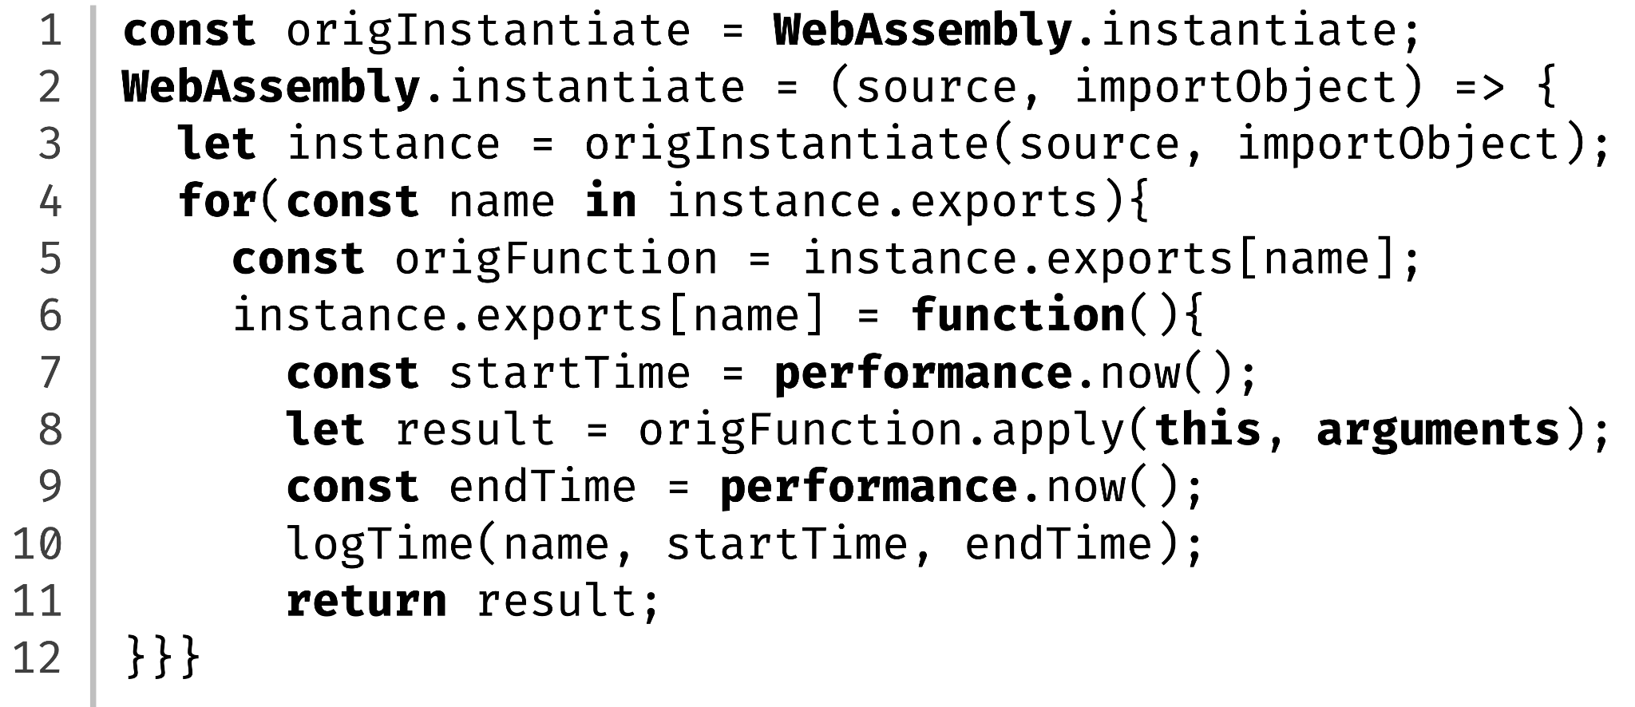
Measuring Runtime through Instrumentation
Instrument WebAssembly export functions using JavaScript-based timer

Slide 34
Hot Function Identification
1. Parse Into LLVM AST
2. Traverse AST for Function Calls in Loops
3. Output List of Identified Function Names
1
2
3
Func_Decl
Func_Decl
Var_Decl
For_Stmt
Var_Decl
For_Stmt
FuncA
FuncB
…
Input
If_Stmt
If_Stmt
Source Code
(.c/.cpp)
Call_Expr_Stmt
Var_Decl
Call_Expr_Stmt
Var_Decl
4. Use function list in modified wasm-opt
4
Output
Emscripten Pipeline
.wasm
Clang
Modified wasm-opt
Module w/ Partial Disabled Inlining

