Slide 1
WASim: Understanding Webassembly Applications Through Classification
Alan Romano Weihang Wang

Slide 2
WebAssembly
Newest web standard
Designed for faster computation-heavy performance
Modules are transmitted as compact binary
Text representation for readability

Slide 3
WebAssembly Adoption
Supported Browsers
Compilation Target For
Used By

Slide 4
What WebAssembly Looks Like
sample.c
sample.wasm
sample.wat
int main(){
int b= 9;
int a = 9;
if(a == b){
return 1;
} else {
return 0;
}
}
00000000: 0061 736d 0100 0000 0117 0560 017f 017f
00000010: 6001 7f00 6000 017f 6000 0060 027f 7f01
00000020: 7f02 2f02 0365 6e76 1665 6d73 6372 6970
00000030: 7465 6e5f 7265 7369 7a65 5f68 6561 7000
00000040: 0003 656e 7606 6d65 6d6f 7279 0201 8002
00000050: 8002 030b 0a03 0402 0000 0102 0100 0006
00000060: 0f02 7f01 41a0 8dc0 020b 7f00 41f4 0b0b
00000070: 0787 010a 115f 5f77 6173 6d5f 6361 6c6c
00000080: 5f63 746f 7273 0001 046d 6169 6e00 0210
00000090: 5f5f 6572 726e 6f5f 6c6f 6361 7469 6f6e
000000a0: 0003 0973 7461 636b 5361 7665 0007 0c73
000000b0: 7461 636b 5265 7374 6f72 6500 080a 7374
...
(func $f0 (result i32)
(local $var0 i32)
i32.const 0
i32.load offset=4
i32.const 16
i32.sub
local.tee $var0
i32.const 0
i32.store offset=12
local.get $var0
...
)
C Source Code
WebAssembly Binary
WebAssembly Text
WebAssembly.instantiate("sample.wasm", imports)
.then(wasm => wasm.instance.exports.f0());
JavaScript Calling Code

Slide 5
Need for Understanding
Text format is readable but quickly becomes incomprehensible
Assembly-like syntax hard to interpret
~42% of modules come from third-party sources
Malicious use cases have been observed in the wild

Slide 6
Module Sections
(module
(type $t0 (func (param i32)))
(type $t1 (func (param i32) (result i32)))
(import "js" "func" (func $js.func (type $t0)))
(func $function1 (type $t1) (param $p0 i32) . . (result i32)
local.get $p0
i32.const 1
i32.store
local.get $p0
i32.load)
(func $function2 (type $t0) (param $p0 i32)
local.get $p0
i32.load offset=8
i32.eqz)
(memory $M0 1)
(table $T0 0 funcref)
(global $g0 (mut i32) (i32.const 0))
(global $g1 (mut i32) (i32.const 123456))
(data $d0 (i32.const 1024) "ABCDE\ff\ff\ff")
(data $d1 (i32.const 1124) "12345\ff")
(export "function1" (func $function1))
(export "otherName" (func $function2)))
Types
Imports
Functions
Memory
Tables
Globals
Data Segments
Exports

Slide 7
Types
(module
(type $t0 (func (param i32)))
(type $t1 (func (param i32) (result i32)))
(import "js" "func" (func $js.func (type $t0)))
(func $function1 (type $t1) (param $p0 i32) . . (result i32)
local.get $p0
i32.const 1
i32.store
local.get $p0
i32.load)
(func $function2 (type $t0) (param $p0 i32)
local.get $p0
i32.load offset=8
i32.eqz)
(memory $M0 1)
(table $T0 0 funcref)
(global $g0 (mut i32) (i32.const 0))
(global $g1 (mut i32) (i32.const 123456))
(data $d0 (i32.const 1024) "ABCDE\ff\ff\ff")
(data $d1 (i32.const 1124) "12345\ff")
(export "function1" (func $function1))
(export "otherName" (func $function2)))
Types
Imports
Functions
Memory
Tables
Globals
Data Segments
Exports
Function signatures that state the number and value types of parameters and the type of the result, if any

Slide 8
Imports
(module
(type $t0 (func (param i32)))
(type $t1 (func (param i32) (result i32)))
(import "js" "func" (func $js.func (type $t0)))
(func $function1 (type $t1) (param $p0 i32) . . (result i32)
local.get $p0
i32.const 1
i32.store
local.get $p0
i32.load)
(func $function2 (type $t0) (param $p0 i32)
local.get $p0
i32.load offset=8
i32.eqz)
(memory $M0 1)
(table $T0 0 funcref)
(global $g0 (mut i32) (i32.const 0))
(global $g1 (mut i32) (i32.const 123456))
(data $d0 (i32.const 1024) "ABCDE\ff\ff\ff")
(data $d1 (i32.const 1124) "12345\ff")
(export "function1" (func $function1))
(export "otherName" (func $function2)))
Types
Imports
Functions
Memory
Tables
Globals
Data Segments
Exports
Functions, variables, tables, or memory buffers passed in from a JavaScript context

Slide 9
Functions
(module
(type $t0 (func (param i32)))
(type $t1 (func (param i32) (result i32)))
(import "js" "func" (func $js.func (type $t0)))
(func $function1 (type $t1) (param $p0 i32) . . (result i32)
local.get $p0
i32.const 1
i32.store
local.get $p0
i32.load)
(func $function2 (type $t0) (param $p0 i32)
local.get $p0
i32.load offset=8
i32.eqz)
(memory $M0 1)
(table $T0 0 funcref)
(global $g0 (mut i32) (i32.const 0))
(global $g1 (mut i32) (i32.const 123456))
(data $d0 (i32.const 1024) "ABCDE\ff\ff\ff")
(data $d1 (i32.const 1124) "12345\ff")
(export "function1" (func $function1))
(export "otherName" (func $function2)))
Types
Imports
Functions
Memory
Tables
Globals
Data Segments
Exports
Declare the function name and signature and define the function code as a sequence of instructions

Slide 10
Memory
(module
(type $t0 (func (param i32)))
(type $t1 (func (param i32) (result i32)))
(import "js" "func" (func $js.func (type $t0)))
(func $function1 (type $t1) (param $p0 i32) . . (result i32)
local.get $p0
i32.const 1
i32.store
local.get $p0
i32.load)
(func $function2 (type $t0) (param $p0 i32)
local.get $p0
i32.load offset=8
i32.eqz)
(memory $M0 1)
(table $T0 0 funcref)
(global $g0 (mut i32) (i32.const 0))
(global $g1 (mut i32) (i32.const 123456))
(data $d0 (i32.const 1024) "ABCDE\ff\ff\ff")
(data $d1 (i32.const 1124) "12345\ff")
(export "function1" (func $function1))
(export "otherName" (func $function2)))
Types
Imports
Functions
Memory
Tables
Globals
Data Segments
Exports
Declare the number of linear memory stores a module will contain (currently limited to 1)

Slide 11
Tables
(module
(type $t0 (func (param i32)))
(type $t1 (func (param i32) (result i32)))
(import "js" "func" (func $js.func (type $t0)))
(func $function1 (type $t1) (param $p0 i32) . . (result i32)
local.get $p0
i32.const 1
i32.store
local.get $p0
i32.load)
(func $function2 (type $t0) (param $p0 i32)
local.get $p0
i32.load offset=8
i32.eqz)
(memory $M0 1)
(table $T0 0 funcref)
(global $g0 (mut i32) (i32.const 0))
(global $g1 (mut i32) (i32.const 123456))
(data $d0 (i32.const 1024) "ABCDE\ff\ff\ff")
(data $d1 (i32.const 1124) "12345\ff")
(export "function1" (func $function1))
(export "otherName" (func $function2)))
Types
Imports
Functions
Memory
Tables
Globals
Data Segments
Exports
Defines the tables that will be used in the module and the number and type of entries they will hold

Slide 12
Globals
(module
(type $t0 (func (param i32)))
(type $t1 (func (param i32) (result i32)))
(import "js" "func" (func $js.func (type $t0)))
(func $function1 (type $t1) (param $p0 i32) . . (result i32)
local.get $p0
i32.const 1
i32.store
local.get $p0
i32.load)
(func $function2 (type $t0) (param $p0 i32)
local.get $p0
i32.load offset=8
i32.eqz)
(memory $M0 1)
(table $T0 0 funcref)
(global $g0 (mut i32) (i32.const 0))
(global $g1 (mut i32) (i32.const 123456))
(data $d0 (i32.const 1024) "ABCDE\ff\ff\ff")
(data $d1 (i32.const 1124) "12345\ff")
(export "function1" (func $function1))
(export "otherName" (func $function2)))
Types
Imports
Functions
Memory
Tables
Globals
Data Segments
Exports
Variables accessible throughout the entire scope of the module

Slide 13
Data Segments
(module
(type $t0 (func (param i32)))
(type $t1 (func (param i32) (result i32)))
(import "js" "func" (func $js.func (type $t0)))
(func $function1 (type $t1) (param $p0 i32) . . (result i32)
local.get $p0
i32.const 1
i32.store
local.get $p0
i32.load)
(func $function2 (type $t0) (param $p0 i32)
local.get $p0
i32.load offset=8
i32.eqz)
(memory $M0 1)
(table $T0 0 funcref)
(global $g0 (mut i32) (i32.const 0))
(global $g1 (mut i32) (i32.const 123456))
(data $d0 (i32.const 1024) "ABCDE\ff\ff\ff")
(data $d1 (i32.const 1124) "12345\ff")
(export "function1" (func $function1))
(export "otherName" (func $function2)))
Types
Imports
Functions
Memory
Tables
Globals
Data Segments
Exports
Bytes used to initialize the linear memory at the given offset

Slide 14
Exports
(module
(type $t0 (func (param i32)))
(type $t1 (func (param i32) (result i32)))
(import "js" "func" (func $js.func (type $t0)))
(func $function1 (type $t1) (param $p0 i32) . . (result i32)
local.get $p0
i32.const 1
i32.store
local.get $p0
i32.load)
(func $function2 (type $t0) (param $p0 i32)
local.get $p0
i32.load offset=8
i32.eqz)
(memory $M0 1)
(table $T0 0 funcref)
(global $g0 (mut i32) (i32.const 0))
(global $g1 (mut i32) (i32.const 123456))
(data $d0 (i32.const 1024) "ABCDE\ff\ff\ff")
(data $d1 (i32.const 1124) "12345\ff")
(export "function1" (func $function1))
(export "otherName" (func $function2)))
Types
Imports
Functions
Memory
Tables
Globals
Data Segments
Exports
Functions, variables, tables, or memory buffers that are passed outside into the JavaScript context to be called there

Slide 15
What does this do?
int sum(int a, int b){
return a + b;
}
(module
(type $t0 (func (param i32 i32)
(result i32)))
(func $_sum (type $t0) (param $p0 i32)
(param $p1 i32) (result i32)
local.get $p1
local.get $p0
i32.add)
(export "_sum" (func $_sum)))

Slide 16
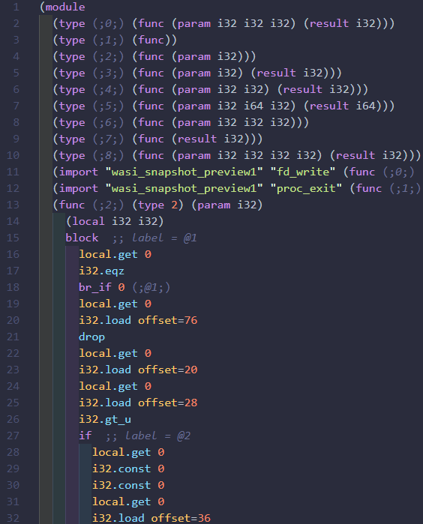
What does this do?
#include <stdio.h>
int main()
{
char* str1 = "Hello world!";
printf("%s\n",str1);
return 0;
}

Slide 17
Malicious Use Cases: Cryptojacking
Secretly mining cryptocurrency when a user visits a web page
WebAssembly is used for intensive cryptographic hashing
Job
Job
1. User visits affected webpage
2.Web page fetches script from mining service
3. Script starts thread with WebAssembly to mine
4. Mining result is sent back to server and mining restarts

Slide 18
Malicious Use Cases: Hidden JavaScript Carrier
JavaScript code is embedded in module and inserted into web page
Can point to malicious pop-ups or redirects
(data $d0 (i32.const 16) "var _tmr=window._tmr||(window._tmr=[]);_tmr.push({id:'2958036',type:'pageView',start:(new Date).getTime()}),function(t,e,r){if(!t.getElementById(r)){var a=t.createElement('script');a.type='text/javascript',a.async=!0,a.id=r,a.src=('https:'==t.location.protocol?'https:':'http:')+'//top-fwz1.mail.ru/js/code.js';var o=function(){var e=t.getElementsByTagName('script')[0];e.parentNode.insertBefore(a,e)};'[object Opera]'==e.opera?t.addEventListener('DOMContentLoaded',o,!1):o()}}(document,window,'topmailru-code');\00"))

Slide 19
WASim: Understanding WebAssembly Applications through Classification
Automatically check the purpose of a module
User can be sure that module is not malicious
Collected
Samples
Training
Features
Store Samples
WebAssembly
Binary
Features
Wasm Collector
Feature Extractor
WebAssembly
Classifier
Url
Classifier
Result
Use Case
Report

Slide 20
Wasm Collector
Responsible for scanning given web page and finding WebAssembly module
Chromium browser (version 77) with --dump-wasm-module flag enabled
Forces engine to write WebAssembly module bytes to file
Controlled through Puppeteer library using Node.js
Collected
Samples
Training
Features
Store Samples
WebAssembly
Binary
Features
Wasm Collector
Feature Extractor
WebAssembly
Classifier
Url
Classifier
Result
Use Case
Report

Slide 21
Sample Gathering Process
Using Wasm Collector:
Crawl Alexa Top 1 Million (as of June 2019)
Scan 17,862 Chrome extensions
Scan 16,385 Firefox add-ons
Scan 112,663,634 GitHub repositories (through Public Git Archive)
Obtain 4,424 (Unique 734) WebAssembly Samples

Slide 22
Feature Extractor
Converts WebAssembly binary modules into text format
WebAssembly samples converted from asm.js by Chrome with customized instruction format
Collects selected metadata on module through text format
Collected
Samples
Training
Features
Store Samples
WebAssembly
Binary
Features
Wasm Collector
Feature Extractor
WebAssembly
Classifier
Url
Classifier
Result
Use Case
Report

Slide 23
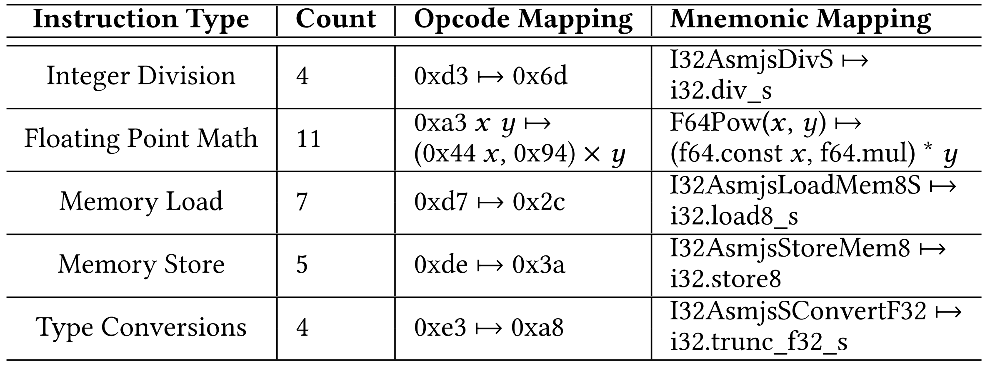
Asm.js WebAssembly Support

Slide 24
Program Features Used
File-Related: Data on the file sizes of the binary and text formats of a module
Program Complexity: Statistical data on the number and sizes of functions defined within the module
WebAssembly Specific: Data that is unique to WebAssembly modules
Function Signature: Textual data on the names of import and export functions
File-
Related
Program Complexity
WebAssembly Specific
Function Signature
,
,
,

Slide 25
File-
Related
Program Complexity
WebAssembly Specific
Function Signature
,
,
,
Binary File Size: 41
Text File Size: 179
Expansion Factor: 4.37
41 bytes
0061 736d 0100 0000 0107 0160 027f 7f01 7f03 0201 0007 0701 0358 4f52 0000 0a09 0107 0020 0020 0173 0b
179 bytes
(module
(type $t0 (func (param i32 i32)
(result i32)))
(func $XOR (type $t0) (param $p0 i32)
(param $p1 i32) (result i32)
local.get $p0
local.get $p1
i32.xor)
(export "XOR" (func $XOR)))

Slide 26
File-
Related
Program Complexity
WebAssembly Specific
Function Signature
,
,
,
Total Lines of Code: 7
Number of Functions: 1
Minimum Lines of Code in Functions: 3
Maximum Lines of Code in Functions: 3
Average Lines of Code in Functions: 3
1
2
3
4
5
6
7
(module
(type $t0 (func (param i32 i32)
(result i32)))
(func $XOR (type $t0) (param $p0 i32)
(param $p1 i32) (result i32)
local.get $p0
local.get $p1
i32.xor)
(export "XOR" (func $XOR)))
1
2
3
4
5
6
7
(module
(type $t0 (func (param i32 i32)
(result i32)))
(func $XOR (type $t0) (param $p0 i32)
(param $p1 i32) (result i32)
local.get $p0
local.get $p1
i32.xor)
(export "XOR" (func $XOR)))

Slide 27
File-
Related
Program Complexity
WebAssembly Specific
Function Signature
,
,
,
Is an Asm.js Module: 0 (false)
Number of Types: 1
Number of Data Sections: 0
Number of Import Functions: 0
Number of Export Functions: 1
1
2
3
4
5
6
7
(module
(type $t0 (func (param i32 i32)
(result i32)))
(func $XOR (type $t0) (param $p0 i32)
(param $p1 i32) (result i32)
local.get $p0
local.get $p1
i32.xor)
(export "XOR" (func $XOR)))
1
2
3
4
5
6
7
(module
(type $t0 (func (param i32 i32)
(result i32)))
(func $XOR (type $t0) (param $p0 i32)
(param $p1 i32) (result i32)
local.get $p0
local.get $p1
i32.xor)
(export "XOR" (func $XOR)))

Slide 28
File-
Related
Program Complexity
WebAssembly Specific
Function Signature
,
,
,
Names Of Import Functions: “” (empty)
Names Of Export Functions: “XOR”
Doc2Vec encodes as numeric vectors of size 10
(module
(type $t0 (func (param i32 i32)
(result i32)))
(func $XOR (type $t0) (param $p0 i32)
(param $p1 i32) (result i32)
local.get $p0
local.get $p1
i32.xor)
(export "XOR" (func $XOR)))
1
2
3
4
5
6
7
(module
(type $t0 (func (param i32 i32)
(result i32)))
(func $XOR (type $t0) (param $p0 i32)
(param $p1 i32) (result i32)
local.get $p0
local.get $p1
i32.xor)
(export "XOR" (func $XOR)))

Slide 29
WebAssembly Classifier
Given the features from the Feature Extractor, predict which of the eleven predefined classes the module belongs to.
Trained and evaluated using 10-fold cross-validation on 734 samples
Collected
Samples
Training
Features
Store Samples
WebAssembly
Binary
Features
Wasm Collector
Feature Extractor
WebAssembly
Classifier
Url
Classifier
Result
Use Case
Report

Slide 30
Purpose Categories
Auxiliary Utility: gives data structures or utility functions
Compression Utility: performs data compression
Cryptographic Utility: performs cryptographic functions
Cryptominer: performs cryptocurrency-mining functions
Game Application: implements full online games
Grammar Utility: performs text or word processing
Image Processing Utility: analyzes or edits images
JavaScript Carrier: stores JavaScript payloads
Numeric Utility: gives mathematical or numeric libraries
Support Checker: checks if WebAssembly is supported
Other Applications: are full standalone programs

Slide 31
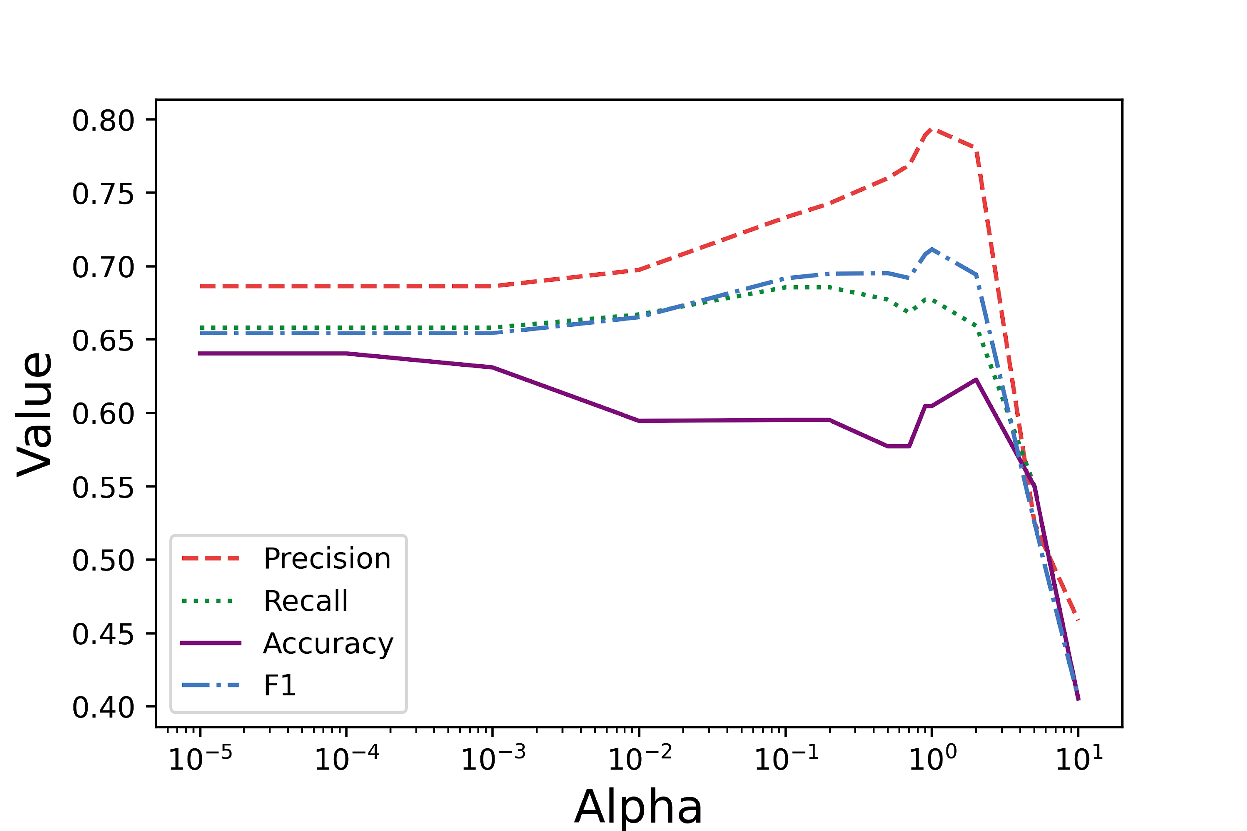
Naive Bayes Classifier
⍺ values tested: 0.00001, 0.0001, 0.001, 0.01, 0.1, 0.2, 0.5, 0.7, 0.9, 1, 2, 5, 10
Dataset split: 10-fold cross validation (train: 661, test: 73)

Slide 32
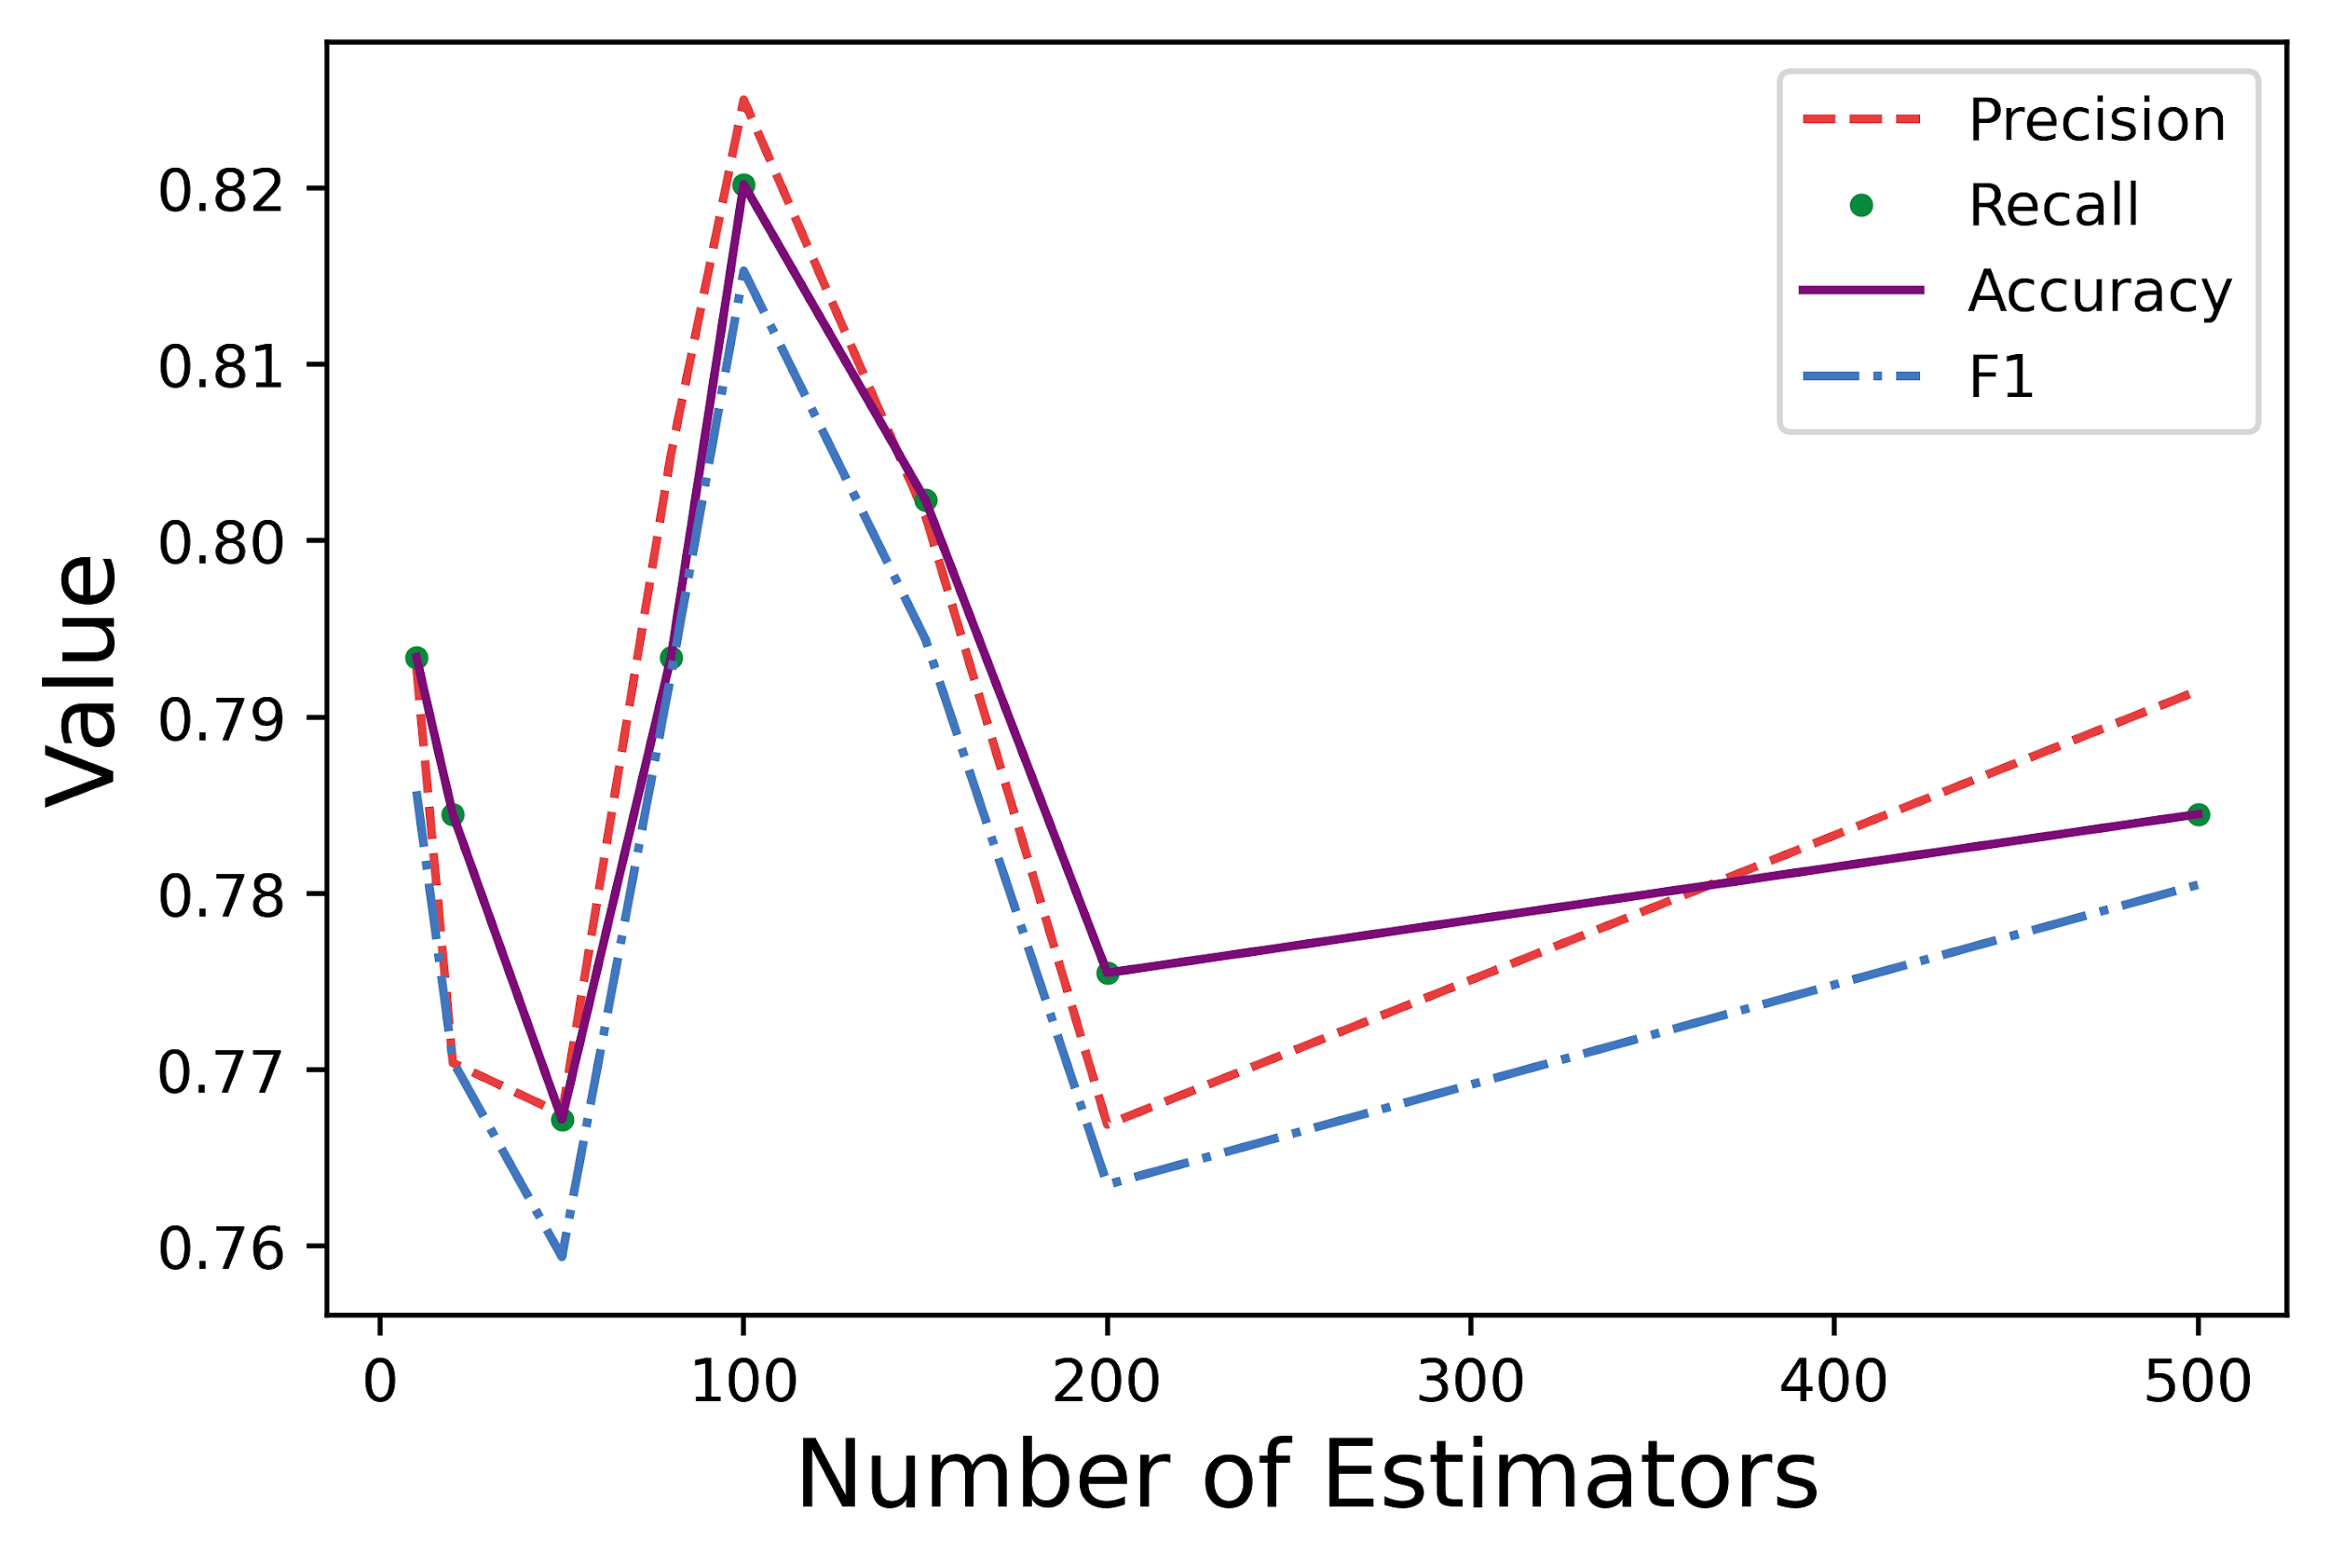
Random Forest Classifier
# of estimators tested: 10, 20, 50, 80, 100, 150, 200, 500

Slide 33
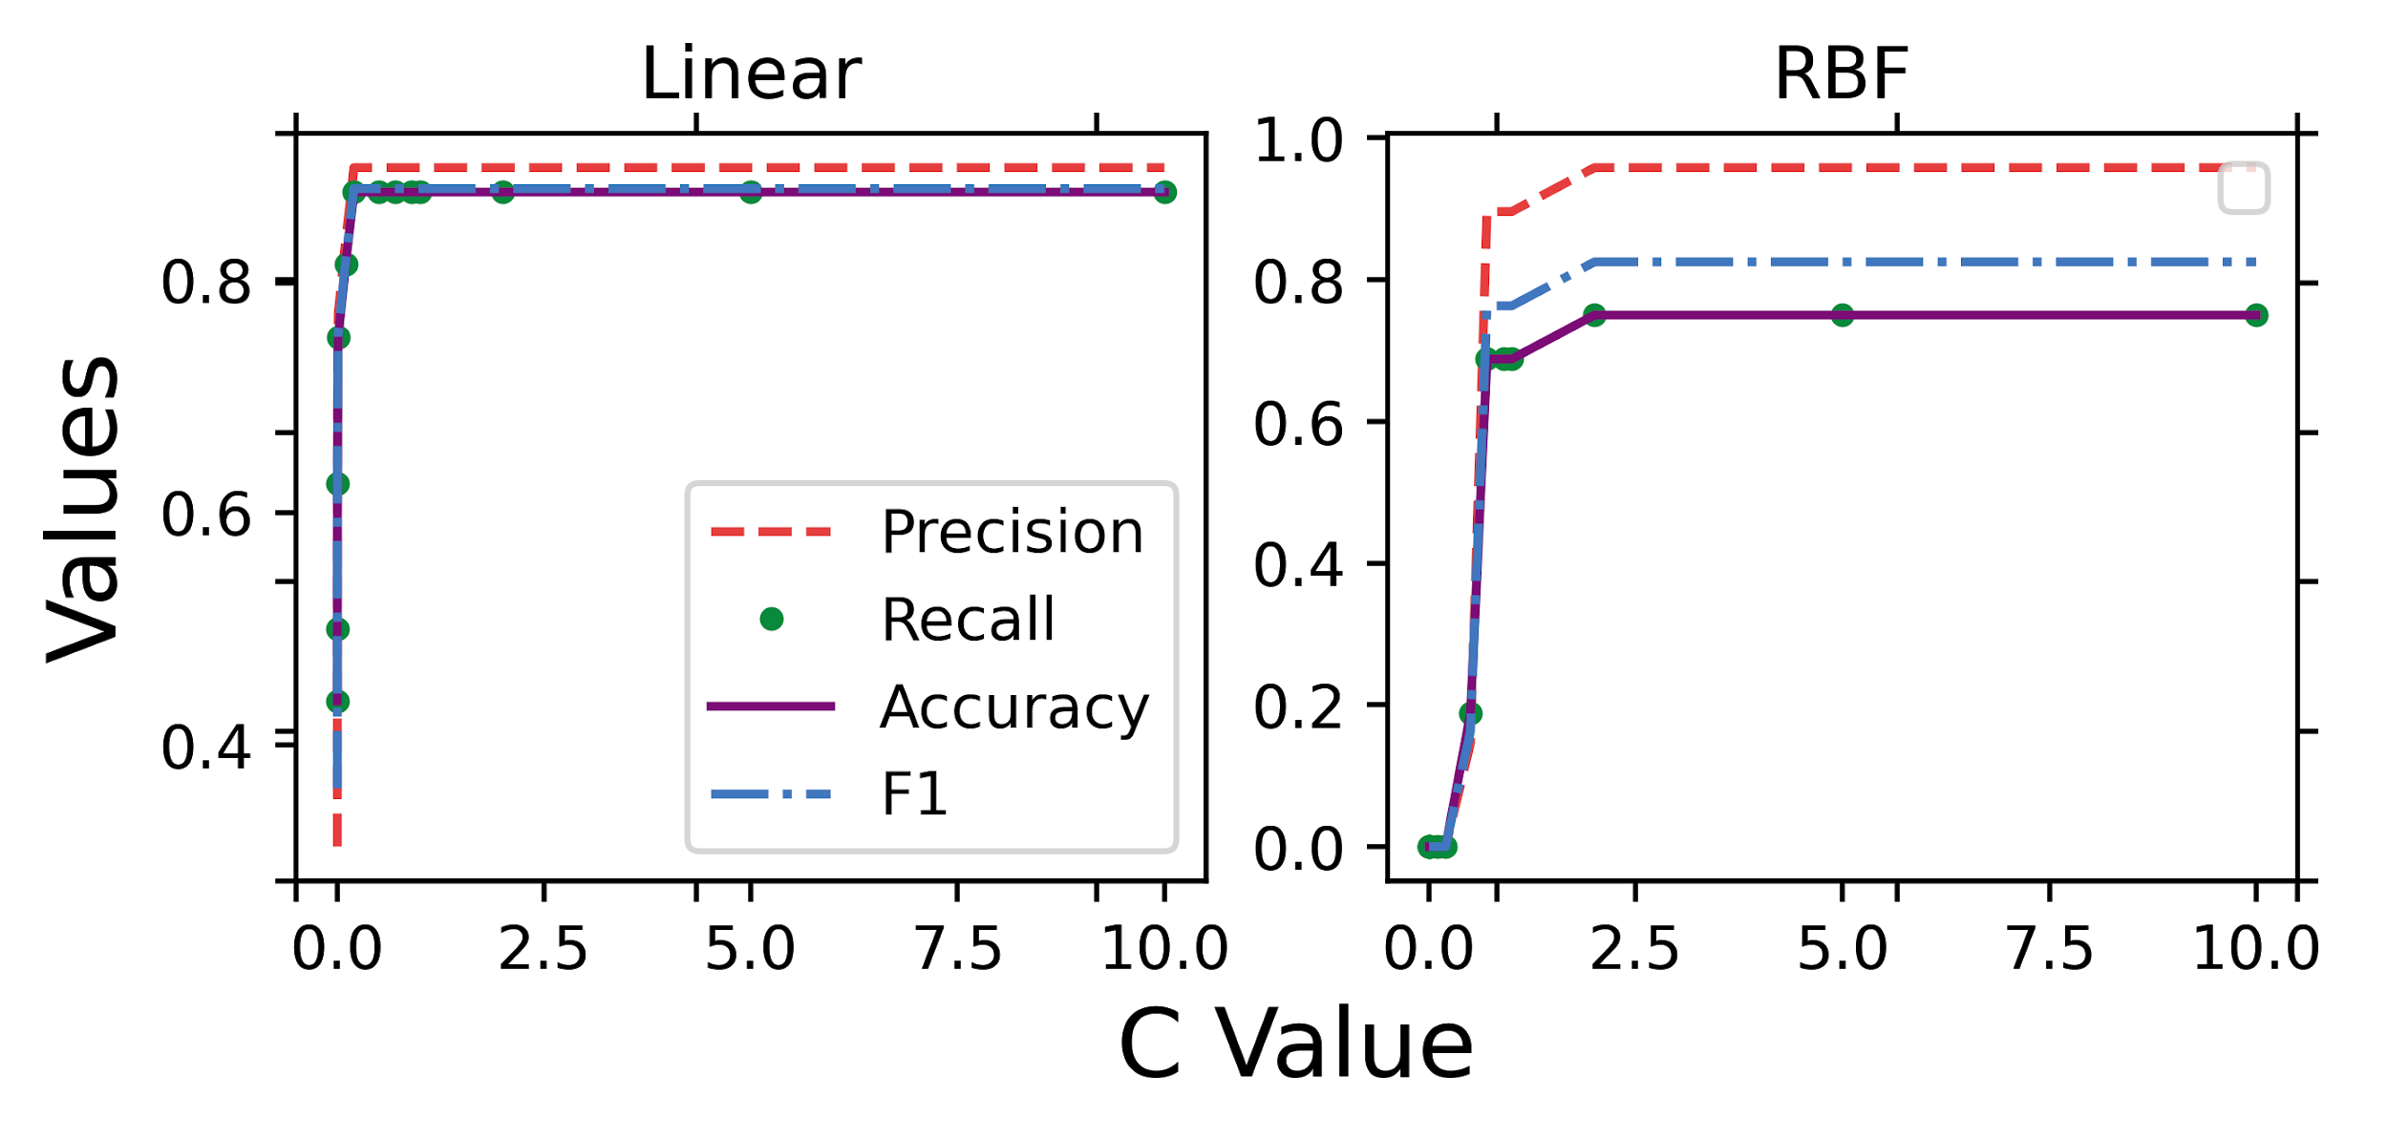
Support Vector Machine Classifier
Kernel functions tested: Linear, Radial Basis Function
C values tested: 0.00001, 0.0001, 0.001, 0.01, 0.1, 0.2, 0.5, 0.7, 0.9, 1, 2, 5, 10

Slide 34
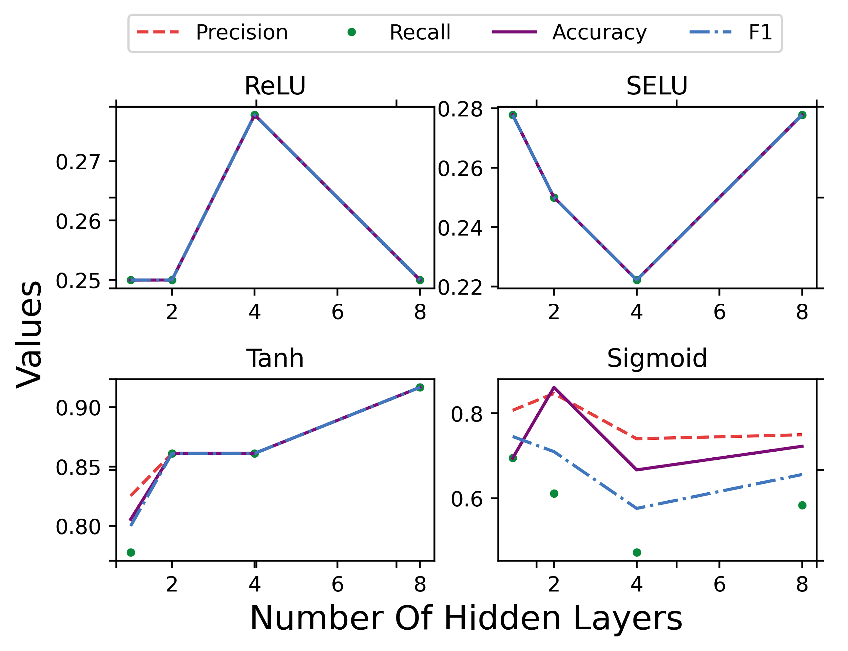
Neural Network Classifier
Activation functions tested: ReLU, SELU, Tanh, Sigmoid
Number of layers tested: 1, 2, 4, 8
Number of nodes per layer: 1000

Slide 35
Demo

Slide 36
Thank you for watching!
Alan Romano
alanroma@buffalo.edu
Weihang Wang
weihangw@buffalo.edu

